Slide 1

DEPARTMENT OF COMPUTER SCIENCE & ENGINEERING
CS451 SEMINAR AND PROJECT PRELIMINARY
Second Review
Date:
Notes:
Welcome the participants to the program.
Introduce yourself and briefly summarize your experience at EY and your interest in presenting at Welcome to EY.
Have co-facilitators, if present, introduce themselves and provide background information.
State the following to help participants understand the context of Welcome to EY:
This course was designed for all ranks around the globe. It provides you with foundational knowledge that will help to explain our culture, our processes and how we go to market.
However, your service line will provide the specifics about your role and your job.
As an organization, we want to invest in you, give you consistent content globally, let you meet other new hires across service lines and meet some of our leaders.

Slide 2
Contents
Team and Guide Details
Introduction
Abstract
Objective
Literature Review
Requirement Analysis
Gantt chart
References
Notes:
Make the following points:
Here you see our four Areas. Across our geographies we operate in approximately 150 countries, offering us worldwide reach. EY has over 190,000 people across the globe.
Our services are provided within four service lines:
Assurance
Advisory
Tax
Transaction Advisory Services (TAS)
Explain that these will be covered in more detail a bit later.

Slide 3
TEAM AND GUIDE DETAILS
Topic: TeachAR- AR classroom for teachers and students.
Team Members
Christy Varghese
Amal Anto
Hanna Elsa Reni George
Jiya George
Guide Name: Prof. Bino Thomas
Notes:
Make the following points:
Here you see our four Areas. Across our geographies we operate in approximately 150 countries, offering us worldwide reach. EY has over 190,000 people across the globe.
Our services are provided within four service lines:
Assurance
Advisory
Tax
Transaction Advisory Services (TAS)
Explain that these will be covered in more detail a bit later.

Slide 4
INTRODUCTION
TeachAR is a teaching tool for teachers to use in order to explain the shape and structure of complex concepts
The app will contain the 3D models of various concepts under the Kerala State syllabus for each classes
The models will give feedbacks on interactions thus making the class more fun and interactive
This app will also be useful in the post covid world as the real life replicas of many things are still not available in most of the schools

Slide 5
ABSTRACT
In current pandemic situation educational institutions shifted their base to virtual platforms.
Virtual method is not as effective as the traditional education system.
Students, especially school students are not able to fully understand the concepts.
Explaining the physical shape and structure of different objects is difficult.
A live 3D image will help the students to capture the idea more clearly.
Notes:
Make the following points:
Here you see our four Areas. Across our geographies we operate in approximately 150 countries, offering us worldwide reach. EY has over 190,000 people across the globe.
Our services are provided within four service lines:
Assurance
Advisory
Tax
Transaction Advisory Services (TAS)
Explain that these will be covered in more detail a bit later.

Slide 6
OBJECTIVE
3D models of various figures.
Teachers can teach by screen sharing with students.
System designed based on the syllabus of the Kerala State Education Board.
Allows students teacher interaction.
Thus making learning a fun and memorable experience.
Notes:
Make the following points:
Here you see our four Areas. Across our geographies we operate in approximately 150 countries, offering us worldwide reach. EY has over 190,000 people across the globe.
Our services are provided within four service lines:
Assurance
Advisory
Tax
Transaction Advisory Services (TAS)
Explain that these will be covered in more detail a bit later.

Slide 7
LITERATURE REVIEW
AR has three key requirements: combining of real and virtual objects in a real environment, aligning of real and virtual objects with each other, and real-time interaction[5]
Intelligent display technology: More than 65% of the information acquired by human beings comes from their own vision, which has become the most intuitive way for human beings to interact with the real environment.[5]
3D registration technology: It determines the relationship between the virtual image, the model and the direction and position information of the camera or display device. Second, the virtual rendered image and model are accurately projected into the real environment, so the virtual image and model can be merged with the real environment.[5]
Notes:
Make the following points:
Here you see our four Areas. Across our geographies we operate in approximately 150 countries, offering us worldwide reach. EY has over 190,000 people across the globe.
Our services are provided within four service lines:
Assurance
Advisory
Tax
Transaction Advisory Services (TAS)
Explain that these will be covered in more detail a bit later.

Slide 8
LITERATURE REVIEW
Intelligent interaction technology: This interaction is based on the fact that people give specific instructions to the virtual object in the scene, and the virtual object can make some feedback, thus enabling the audience of the augmented reality application to achieve a better experience.[5]
AR technologies enable users to experience scientific phenomena that are not possible in the real world. This type of learning experience can encourage thinking skills and increase conceptual understanding of phenomena that are either invisible or difficult to observe as well as correct any misconceptions[6]

Slide 9
LITERATURE REVIEW
The immersion and interaction features offered by AR may encourage students to engage in learning activities and may improve student motivation to learn[6]
Augmented Reality Development Tools: ARKit (Apple), ARCore(Google), Vuforia, Unity.

Slide 10
LITERATURE REVIEW
Anatomy 4D: It allows viewers to understand and interact with complex information with unprecedented ease, speed, and depth. Visually stunning and completely interactive, augmented reality is the perfect vehicle for 21st century education.
Science AR: Makes the Science AR posters come alive. This App works in conjunction with the Science AR posters.
Chemistry 101: It revolutionizes the way to study formulation. With this app you will have in your hands the elements of the periodic table so that you can create thousands of chemical compounds.

Slide 11
LITERATURE REVIEW
Quiver: Coloring pages have never been so much fun! The Quiver App combines physical coloring from “back in the day” with state of the art augmented reality technology to bring you and your children an extraordinarily magical experience.
Physics Lab AR: Learn science by doing experiments in your virtual lab with Physics Lab.
Brain 3D: Discover how each brain region functions, what happens when it is injured, and how it is involved in mental illness. Each detailed structure comes with information on functions, disorders, brain damage, case studies, and links to modern research.

Slide 12
REQUIREMENT ANALYSIS
USER REQUIREMENTS
The app should be user-friendly and easy to use as teachers are not that tech savvy.
The content in the app should be updated according to the syllabus.
Add a options for conducting education related quizzes through the app.
Able to show content on complex mathematics.
Students should be notified when a doubt is cleared.
The app must be free and require less external devices.
Notes:
Make the following points:
Here you see our four Areas. Across our geographies we operate in approximately 150 countries, offering us worldwide reach. EY has over 190,000 people across the globe.
Our services are provided within four service lines:
Assurance
Advisory
Tax
Transaction Advisory Services (TAS)
Explain that these will be covered in more detail a bit later.

Slide 13
REQUIREMENT ANALYSIS
SOFTWARE REQUIREMENTS
Unity 2019
Blender 2.90
Vuforia 9.2
Adobe Photoshop
Adobe Xd
Creately
GitHub
HARDWARE REQUIREMENTS
Android 7.0+
System above windows 8.0+ and should contain 4GB+ RAM.

Slide 14
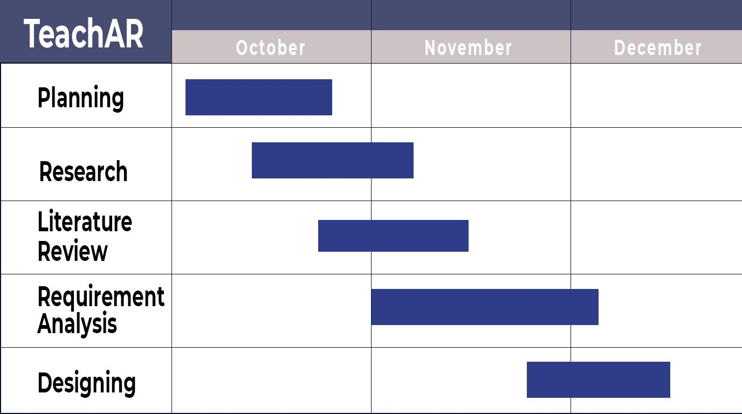
GANTT CHART
Notes:
Make the following points:
Here you see our four Areas. Across our geographies we operate in approximately 150 countries, offering us worldwide reach. EY has over 190,000 people across the globe.
Our services are provided within four service lines:
Assurance
Advisory
Tax
Transaction Advisory Services (TAS)
Explain that these will be covered in more detail a bit later.

Slide 15
REFERENCES
[1] Infusory. 2020. Interactive Learning Through AR: Tutar | Next Reality Classroom - Infusory. [online] Available at: <https://infusory.in/interactive-learning-through-ar-next-reality-classroom/> [Accessed 18 October 2020].
[2]Edutopia. 2020. 6 Exciting AR Apps For Student Learning. [online] Available at: <https://www.edutopia.org/blog/ar-apps-for-student-learning-monica-burns> [Accessed 17 October 2020].
[3]Play.google.com. 2020. [online] Available at: <https://play.google.com/store/apps/details?id=com.AugmentedClass.AClass&hl=en_IN&gl=US> [Accessed 17 October 2020].
[4]Alive Studios | Reading and Math Programs for Early Education. 2020. Math Alive | Supplemental Math Program | Prek To 3Rd Grade | Alive Studios. [online] Available at: <https://alivestudiosco.com/math-alive-kit/> [Accessed 18 October 2020].

Slide 16
REFERENCES
[5]An overview of augmented reality technology / Yunqiang Chen, Qing Wang, Hong Chen, Xiaoyu Song, Hui Tang, Mengxiao Tian/<https://iopscience.iop.org/article/10.1088/1742-6596/1237/2/022082/pdf/>[Accessed 7 November 2020]
[6]The Impact of an Augmented Reality Application on Learning Motivation of Students /Tasneem Khan, Kevin Johnston, and Jacques Ophof/ <https://www.hindawi.com/journals/ahci/2019/7208494/#literature-review/>[Accessed 18 November 2020]
[7] AR Makr <https://edshelf.com/tool/ar-makr/> [Accessed 28 Novemeber]

Slide 17
Thank You

